Slide 1
Mobile Marketing for Bars & Clubs
What is Mobile Marketing?
And Why Should You Care?
Using cellular to engage with prospects & customers who’ve asked to hear from YOU
Combines elements of print signage, SMS (text messages), mobile web, and a “mobile wallet”
Trivia games, polls & questions, drawings and contests, coupons, event/listing notifications, etc.
Uses SMS (texting) as the communications channel for the deepest user penetration and ease of use
80% of cell phone owners text, up from 58% in 2007 (Pew Research, Dec. 2012)
In the US, 75% send text messages, 49% use apps and 49% browse internet (ComScore, 2012)
49% of those who use social media prefer texting to calling (Performics, Jan 2012))
Studies indicate 97% read SMS (text) within 15 minutes; 84 % within 1 hour (Nielsen, 2012)

Slide 2
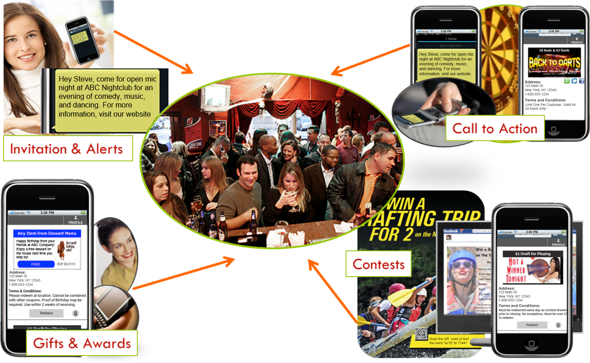
SMS Engagement

Slide 3
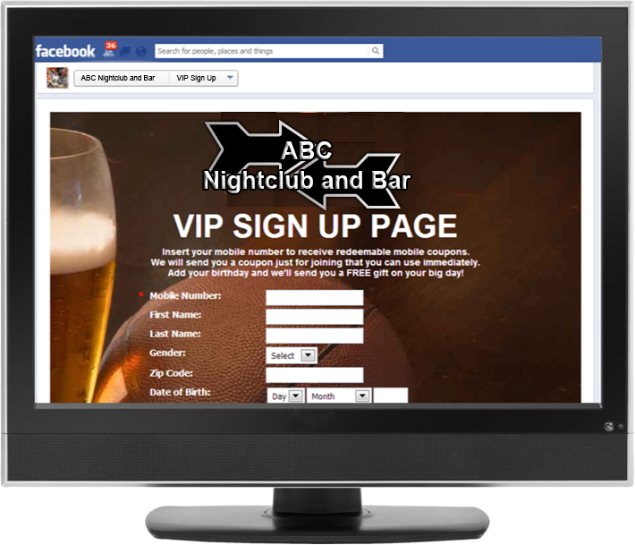
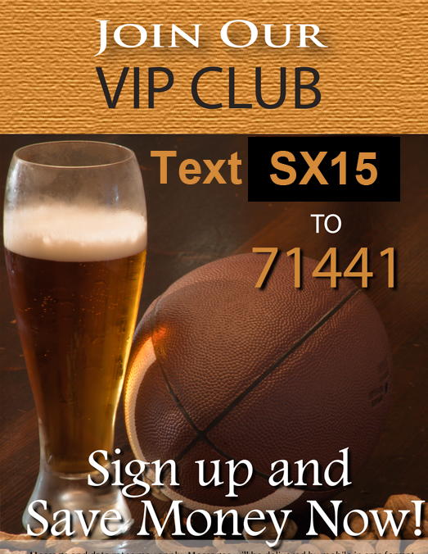
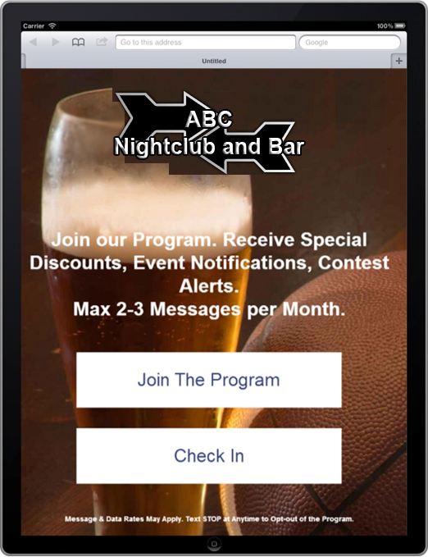
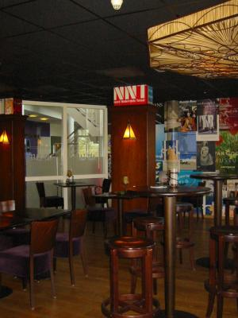
Building Opt-in Lists
There are many ways to develop your ‘opt-in’ participant lists
A self-service kiosk can be created using a WYSIWYG interface in minutes
Use posters and signs in your bar to promote participation.
‘Drop-in’ ready Facebook, Web, and Mobile opt-in form code is auto-generated by the platform.

Slide 4
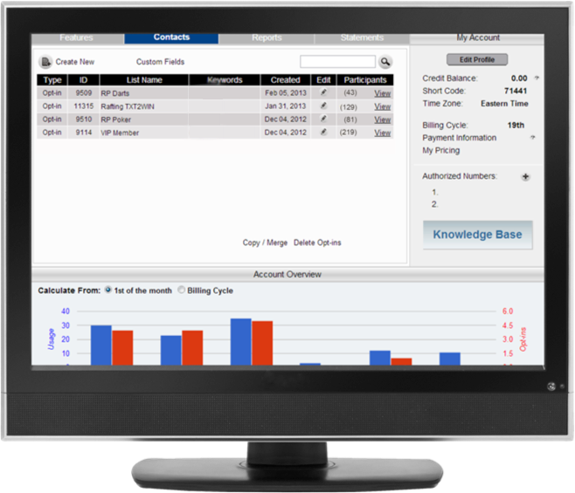
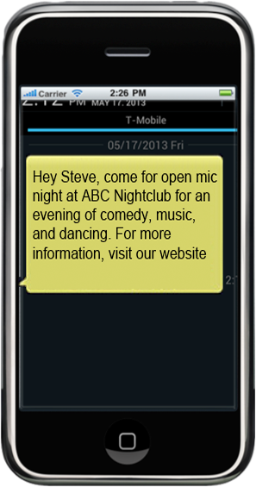
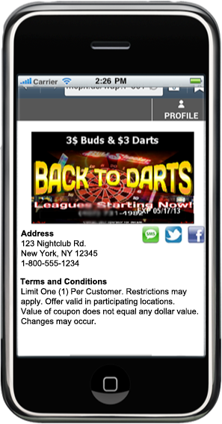
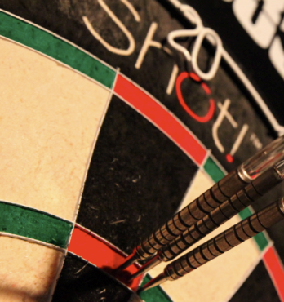
Segmenting Customers into Affinity Groups
Organize clients into affinity groups to ensure targeted and relevant communications
SMS ‘contact lists’ allow segmentation & targeting
Consider opt-in groups to promote & establish tournaments and events, e.g. Poker, Darts, Football, etc.
Targeted messages to affinity groups can establish YOUR club as ‘the’ gathering place

Slide 5
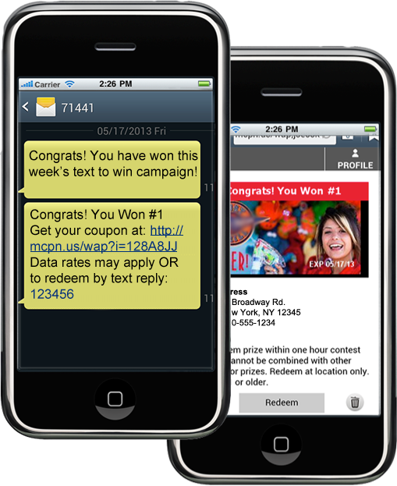
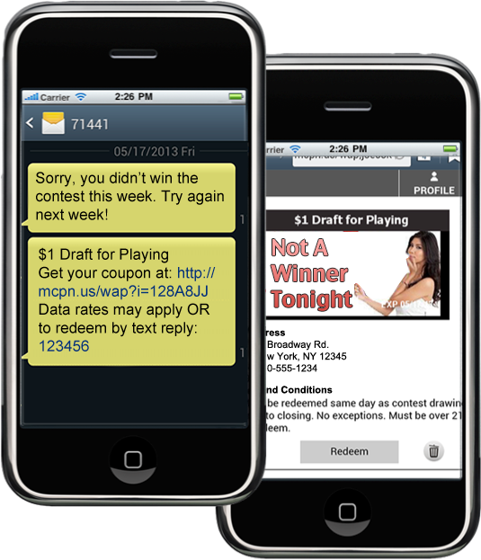
TXT2Win Contests
SMS contests present a fun way to engage with a purpose – drive more sales.
A midnight drawing is the perfect way to ‘hold’ patrons in the bar till closing

Slide 6
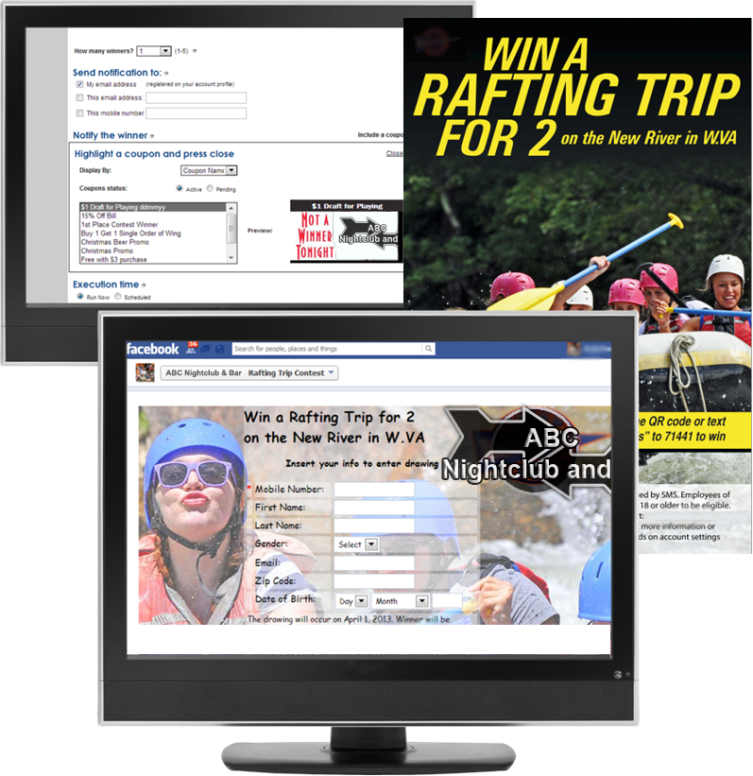
Defining TEXT2WIN Contests is a Snap
Draw from an entire opt-in list or narrow down to only those who’ve ‘texted in’ during a specified ‘entry’ period
Multiple winners can be defined, e.g., 1st, 2nd, 3rd place
Each winner can be provided with a different award
Losing players can be awarded a consolation prize
Contests can be scheduled in advance, making regular drawings easy to run
Winning number notifications can be sent via email, text to manager for prize verification

Slide 7
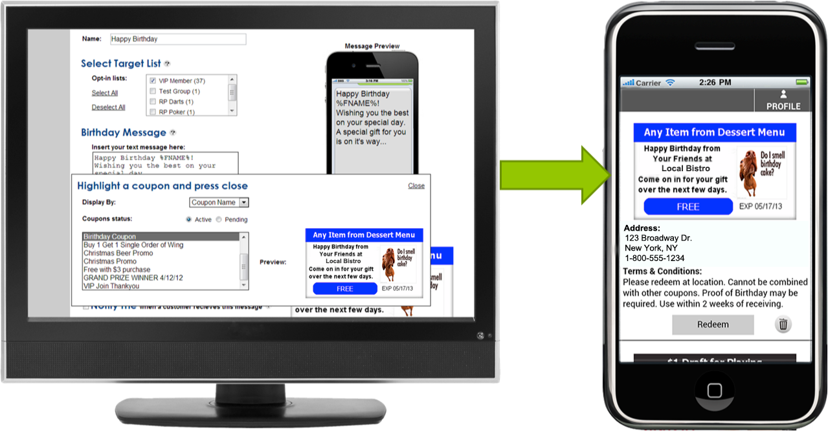
Use Birthday Wishes to Increase Loyalty
Sent automatically, birthday wishes provide an easy way to drive repeat business
Automatically have your birthday coupons sent a few days before or on the day of your customers’ birthday.
All of the BIG chains send Birthday Wishes for good reason – they increase loyalty!

Slide 8
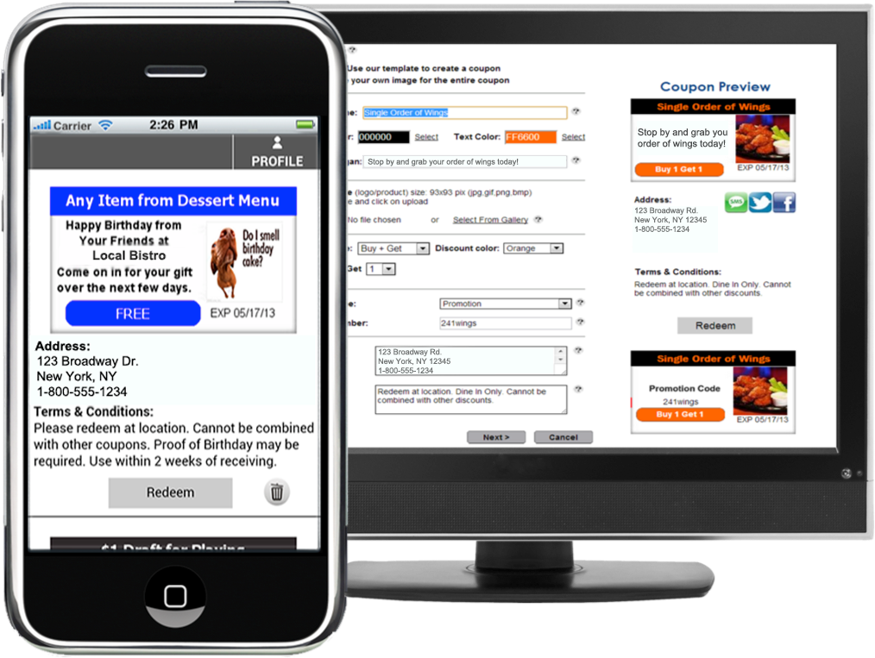
Coupons, a powerful sales driver
Our platform offers the best couponing capability in the industry
Consider these facts:
87% of all shoppers use coupons (source: Advertising Age)
16.5% of US adult mobile phone users redeem mobile coupons. Mobile coupon use expected to rise from 12.3M in ‘10 to 53.2M in ‘14
By 2014 1-in-4 will redeem a mobile coupon (Source: eMarketer)
Global redemption rate of mobile coupons to average at over 8% by 2016 (Juniper Research)
Inexpensive compared with print

Slide 9
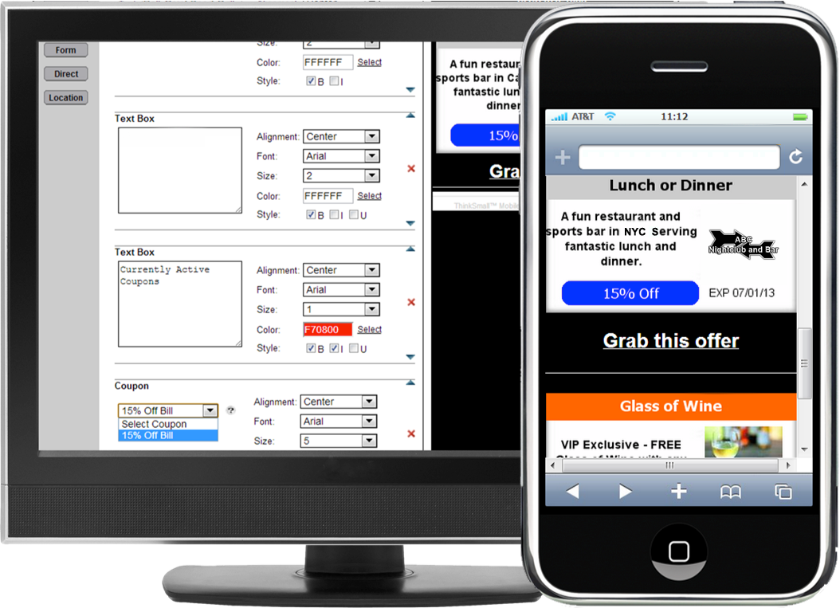
‘Grab & Go’ Coupon Landing Pages
For businesses that run regular promotions, a landing page can be setup to allow prospects to grab the coupons they want as desired
The first time a user grabs an offer, they are entered into an opt-in list
Promotions of your coupon landing can be done via signage or social media and is a quick way to building a loyal following of opt-ins

Slide 10
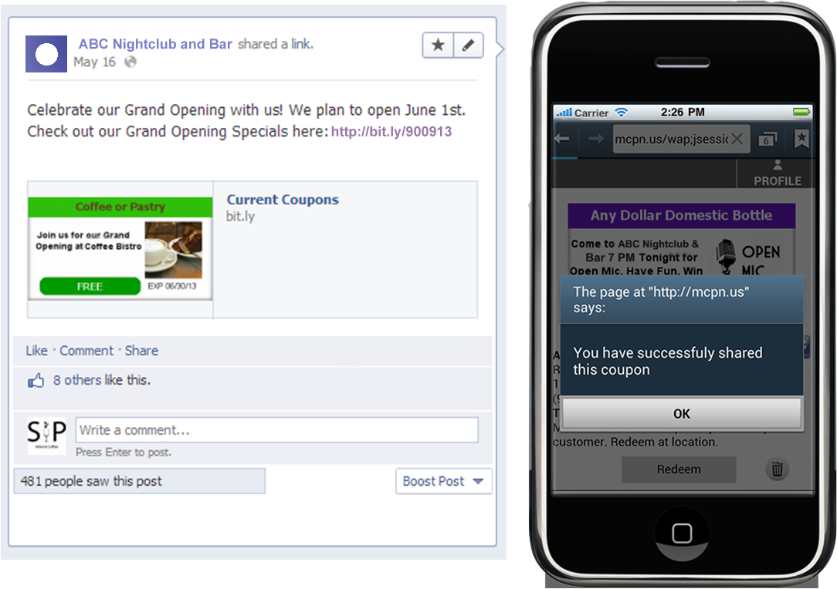
Viral Sharing
With viral sharing of offers, your opt-in list will grow quickly
Because of viral sharing, this offer generated 34 new opt-ins over an 3 hour period!

Slide 11
SMS for Bars and Clubs is Affordable & Easy
SMS offers a low-cost investment with high value rewards.
Reward repeat and loyal customers
Provide a fun and engaging marketing channel that will drive sales
Increase the speed and efficiency of alerting your customers of events
Lime’s platform provides an easy, affordable, and fully functional platform for engaging with clients using the most premium and effective marketing channel there is today – SMS

